Slide 1
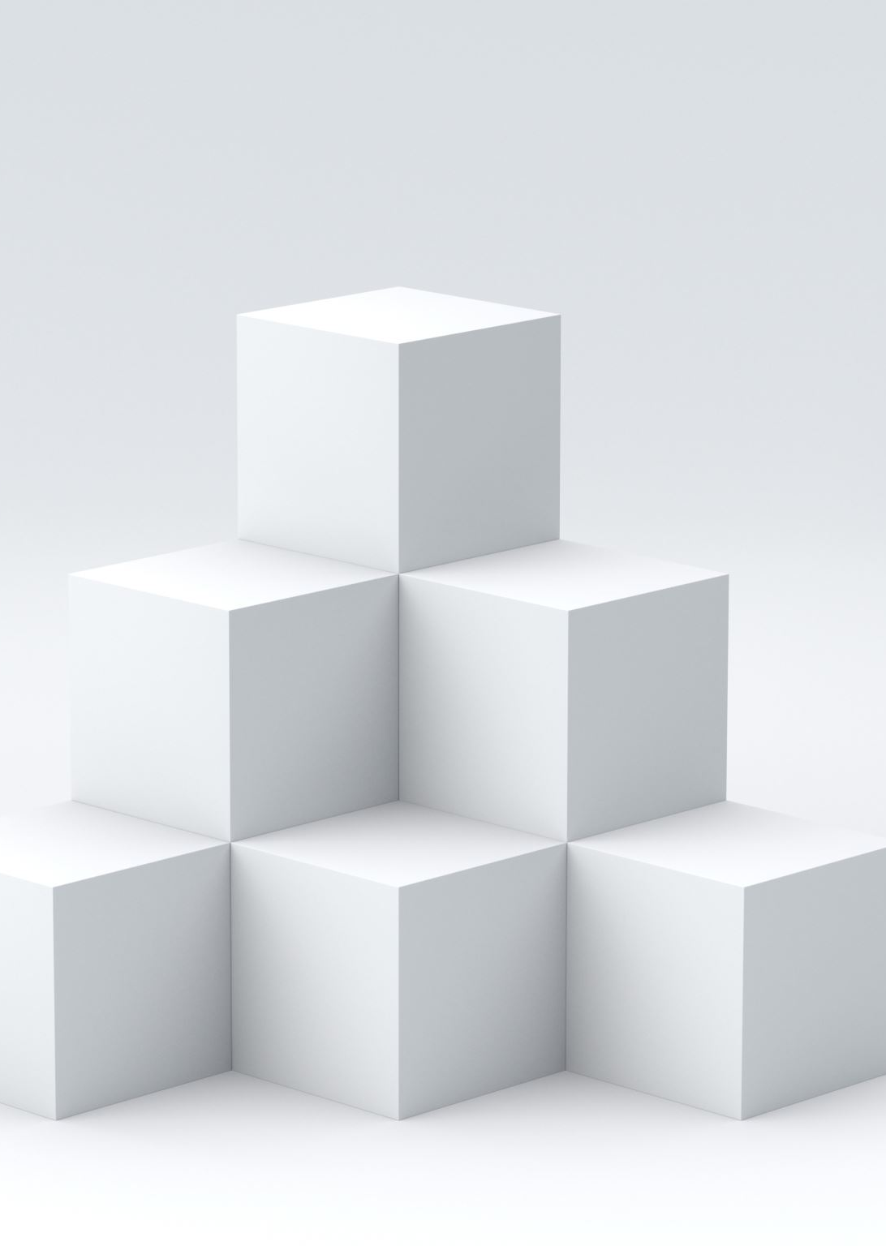
Deca-Cube
Final Product

Slide 2
Table of Contents
Game Overview
New Additions
Code Review
Tools Used
Music Demonstration
Game Demonstration
Thank You

Slide 3
Game Overview
Deca-Cube is a top-down collect-a-thon game
Player must collect 10 items and return to the starting area to win the game
Collision with an enemy causes a life to be lost
Losing all lives loses the game

Slide 4
New Additions
Added enemy behaviour
Added sounds and music
Added scoreboard
Added results screen
Added scoring

Slide 5
Code Review
Different Movement Types

Slide 6
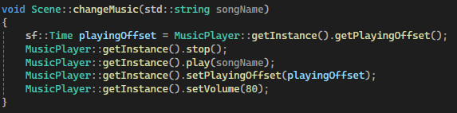
Music Changing
Music is layered

Slide 7
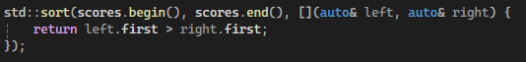
Sort Scores from High to Low

Slide 8
Tools Used
The game couldn’t be where it is without these

Slide 9

IDE
Visual Studio 2022
Microsoft, 2021

Slide 10

Graphics System
SFML 2.6.1
Laurent Gomila, CC0, via Wikimedia Commons

Slide 11

Art Program
Photopea
Ivan Kutskir, Public domain, via Wikimedia Commons

Slide 12

Music Maker
Bosca Ceoil: The Blue Album
YuriSizov, creator of Bosca Ceoil, 2025

Slide 13
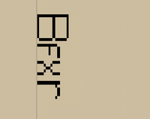
Sound Maker
Bfxr
Increpare, creator of Bfxr, 2021

Slide 14

Music
Music system inspired by Rain World
Layered music, more instruments added based on game progress
Level theme, one instrument
Menu theme
Level theme, three instruments
Victory theme

Slide 15
Game Presentation

Slide 16
Thank you for Listening

